Slide 1
Causal Impact
Josip Ćurković

Slide 2
Table of contents
What is the goal of this project?
What is causal impact?
Packages and data sets
Causal impact on an artificial data set
Causal impact on a real world data set
Conclusion
References

Slide 3
What is the goal of this project
To show the causal impact of Elon Musk purchasing Twitter on the Tesla stock.
Using the Causal impact package.

Slide 4
What is causal impact?
Made by Google
Used to create a Bayesian structural time series model
Based on one or multiple control groups.
Used to estimate how an intervention affects a time series.

Slide 5
Packages and data sets
CausalImpact
Yfinance
Pandas
Seaborn
Matplotlib

Slide 6
Artificial data set
1. Need to create a control and response time series.
2. Set the date indexes.
3. Determine the pre and post period
4. Compue the Causal Impact.

Slide 7
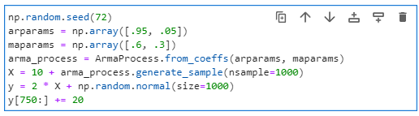
1. Create a control and response time series and Set the intervention time and impact
Set a seed
Generate an autoregressive moving average ( ARMA ) process
Using the ARMA process generate the control time series
From the control time series generate the response time series

Slide 8

2. Set the date indexes
Generate dates equal to the number of periods specified when creating the control and response series.
Set them as the indexes of your data frame.

Slide 9

3. Determine the pre and post periods
Set the pre period as the period from the beginning of the data until the point right before the intervention
Set the post period as the period from the intervention start date until the end.

Slide 10
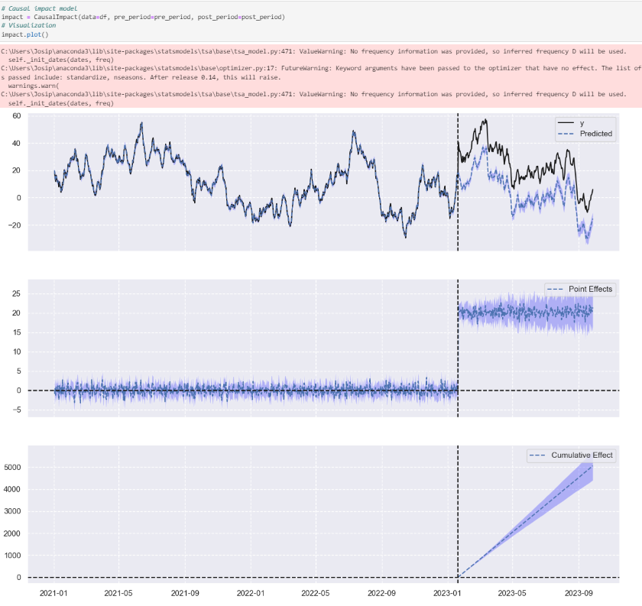
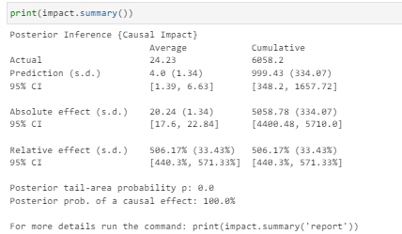
4. Compute the Causal Impact

Slide 11
Causal Impact on the Tesla stock after Elon Musk’s acquisition of Twitter.
1. import libraries and specify dates
2. Get your data and clean it up
3. Compute the correlation matrix to determine which data to keep in the control group
4. Define the pre and post periods
5. Compute the Causal Impact.

Slide 12
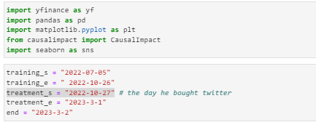
1. Import libraries and specify dates
Training dates are from the start of the dataset until the start of the intervention
Treatment dates are from the start of the intervention until the end

Slide 13
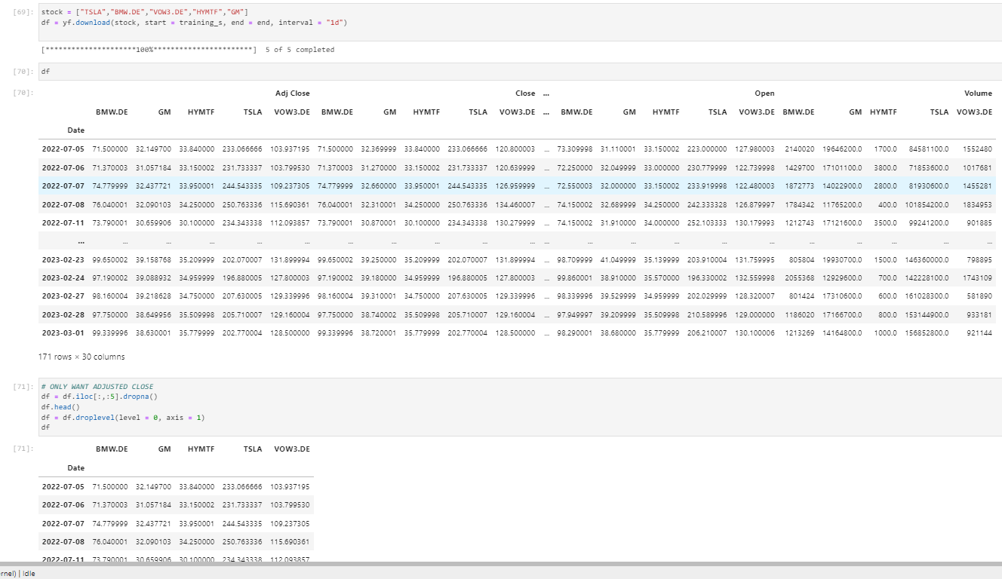
2. Get your data and clean it.

Slide 14
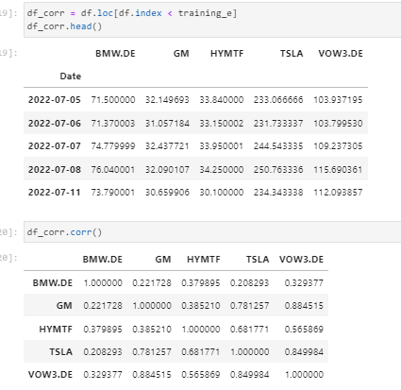
3. Compute the correlation matrix to determine which data to keep in the control group
We compute the correlation matrix only using the data in the pre period.
We see that Tesla is fairly correlated with every company except for BMW
Because of this we remove BMW from our final data set.

Slide 15

4. Define the pre and post periods.
The pre period is the period from the training start until the end of the training
The post period is the period from the start of the treatment until the end of the treatment

Slide 16
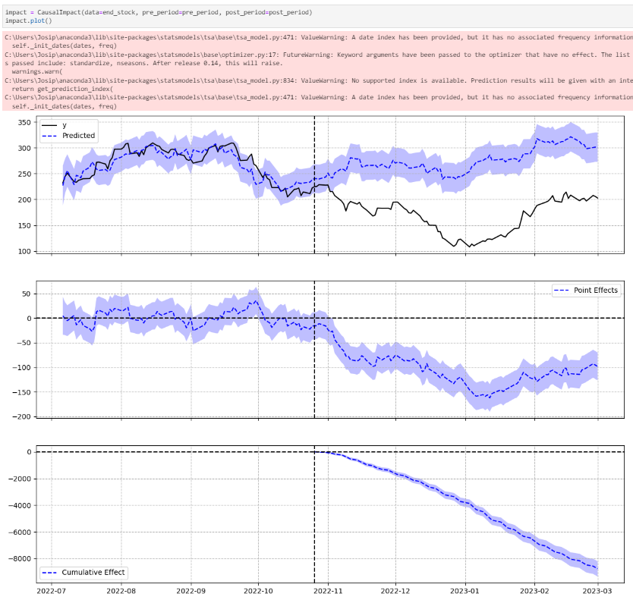
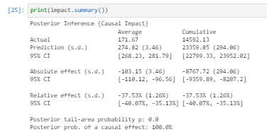
5. Compute the Causal Impact
The average prediction is higher than the actual average by 103.15 units
Average decrease in 37.53%
posterior tail-area probability is equal to 0.0 which means that the causal impact is statistically significant

Slide 17
Conclusion
We can conclude that Elon Musk’s purchase of Twitter and the rash decision he has done on the website following the purchase affected the Tesla stock severely

Slide 18
References
(2020, 6 3). Retrieved from https://www.youtube.com/watch?v=86IEGJI1BlU
Amy. (2022, 9 10). Medium. Retrieved from Time Series Causal Impact Analysis in Python: https://medium.com/grabngoinfo/time-series-causal-impact-analysis-in-python-63eacb1df5cc
Brodersen, K. (2016, 12 13). Retrieved from https://www.youtube.com/watch?v=GTgZfCltMm8&t=206s
Seer Interactive. (2021, 10 5). Retrieved from What Is a Causal Impact Analysis and Why Should You Care?: https://www.seerinteractive.com/insights/what-is-a-causal-impact-analysis-and-why-should-you-care
Senouci, J. (n.d.). nbviewer. Retrieved from Causal Impact: https://nbviewer.org/github/jamalsenouci/causalimpact/blob/master/GettingStarted.ipynb

